Slide 1
Delta Live Tables Building Reliable Data Pipelines Modern data engineering in the lakehouse
Nagaraj Sengodan
Notes:
Ver 2020-1119
Presenter's Name
Presenter's Name

Slide 2

Nagaraj Sengodan
Cloud Solution Architect
Specialized in data and AI Consulting, Strategy, Solution Architecture, and Implementation
Expertise in data management to help partners and customers be successful in large-scale analytics initiatives.
https://uk.linkedin.com/in/NagarajSengodan

Slide 3
Introduction
Delta Live Tables (DLT) is an ETL framework that uses a simple declarative approach to build reliable data pipelines and automatically manage the infrastructure at scale
DLT allows the developer to focus on the core transformation logic by abstracting away all the surrounding operational complexity.
Let’s explore
Notes:
In today's ever-changing business world, organizations know they need to make the most of their extensive data to gain valuable insights. However, dealing with the challenges of data and analytics can be tough.
"Enterprises navigate data complexity to thrive in a fast-paced market, while Microsoft Fabric offers simplicity through OneLake and Unified Analytics. Let's delve into the details."
Microsoft Fabric is a comprehensive solution designed to address the complex data and analytics challenges faced by modern enterprises.

Slide 4
Databricks Data Intelligence Platform
Data Science & AI
ETL & Real-time Analytics
Workflows
Job cost optimized based on past runs
Databricks SQL
Text-to-SQL
Mosaic AI
Create, tune, and serve custom LLMs
Delta Live Tables
Automated data quality
Orchestration
Data Warehousing
Mosaic AI
Workflows
Databricks SQL
Use generative AI to understand the semantics of your data
Data Intelligence Engine
Unified security, governance, and cataloging
Unity Catalog
Securely get insights in natural language
Unity Catalog
Delta Lake
Data layout is automatically optimized based on usage patterns
Unified data storage for reliability and sharing
Delta Lake
Open Data Lake
All Raw Data
(Logs, Texts, Audio, Video, Images)
Notes:
In Unity Catalog, you can securely find data and understand tables with natural language that uses your company jargon
For example, in Databricks we have over 500,000 tables. Finding the right one is a huge challenge.
But, because the Intelligence Engine understands my data and the relationships between it, a developer can be guided to the right data just by asking.
In Delta Lake, the IE is able to automatically optimize the data for you.
You don’t have to worry about things like indexing and partitioning yourself.
In data warehousing, we’re able to do a lot behind the scenes to optimize query performance
But, one thing that will deliver a lot of simplicity and efficiency for your analysts is text-to-SQL
You just need to specify queries in natural language, and Databricks will generated the necessary code
For orchestrating jobs, the IE automatically selects the right instances and start time to hit your requirements
It handles things like auto-scaling and error remediation to for you
For those job themselves, we can do automated data quality monitoring
The IE can detect when model quality is skewing, automatically flag it, and assist in remediation
Finally, on the AI side, we’re really excited about how the platform enables you to build your own generative AI applications

Slide 5

Lakehouse Platform
Data Sources
Data Engineering on the Databricks Lakehouse Platform
Databases
Streaming Sources
Cloud Object Stores
SaaS Applications
NoSQL
On-premises Systems
Data quality management
Delta Live Tables
Scheduling & orchestration
Databricks Workflows
Data Consumers
Delta Sharing
BI / Reporting
Dashboarding
Machine Learning / Data Science
Data Products
Data ingestion
Auto Loader
Data transformation
Delta Live Tables
Open format storage
Delta Lake
Notes:
With the Databricks Lakehouse Platform, data engineers have access to an end-to-end data engineering solution for ingesting, transforming, processing, scheduling and delivering data. The lakehouse platform automates the complexity of building and maintaining pipelines and running ETL workloads directly on a data lake so data engineers can focus on quality and reliability to drive valuable insights.

Slide 6
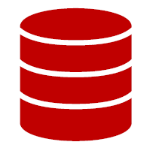
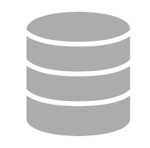
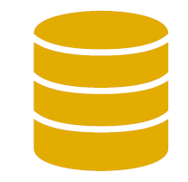
Medallion Architecture
Although the 3-layered design is common and well-known, there are many discussions on the scope, purpose, and best practices on each of these layers.
Bronze layer Typically raw, "as-is"
Maintains the raw state in the structure “as-is”
Data is immutable (read-only)
Delivery-based partitioned tables, i.e., YYYYMMDD
Mostly Parquet or Delta. Sometimes other formats
Can be any combination of streaming and batch transactions
May include extra metadata (schema)
May be fed from a “mediation layer”
Used for debugging, testing
Silver layer Cleaned, filtered
Uses data quality rules for validation
Usually only functional data
Historization is merged (SCD2)
Efficient storage format; Delta
Technical versioning for rolling back
Handles missing or incorrect data
Usually enriched with reference data
Source-oriented, although queryable and cluttered around subject areas
Usually used by operational analytical teams
Gold layer Refined business-level
What enterprises call data products: consumer-ready / user-friendly data
Data is highly governed and well-documented
Historization is applied only for the set of use cases or consumers
Contains complex business rules, such as calculations and enrichments
Efficient storage format; Delta
Functional versioning for rolling back
Might contain additional sub layers for sharing or distributing data

Slide 7
Databricks Data Intelligence Platform
Delta Live Tables
Mosaic AI
Create, tune, and serve custom LLMs
Delta Live Tables
Automated data quality
Workflows
Job cost optimized based on past runs
Databricks SQL
Text-to-SQL
Data engineer
Ingestion
Automatic Lineage
Data Quality
SCD
Management
Operational Metrics
Workflow
Reports
Use generative AI to understand the semantics of your data
Data Intelligence Engine
Unity Catalog
Securely get insights in natural language
Delta Lake
Data layout is automatically optimized based on usage patterns
Open Data Lake
All Raw Data
(Logs, Texts, Audio, Video, Images)
Notes:
You can both build models from scratch or tune existing models on your data to maintain privacy and control
We can serve those models for you really efficiently
And we can help you do RAG to build conversational agents with APIs like OpenAI that are really high quality
But it’s not just about building and serving models
Databricks AI covers the end-to-end AI workflow to help you deploy and manage models all the way through production
We provide transparent AutoML to help you find the best model quickly without any loss of control
Monitoring of models to give insight into how they’re evolving in production and identifying drift
And, most importantly, governing your models
We can help ensure the results are reproducible and maintain your standards and compliance rules
Best of all, because it’s all built on the open foundation of MLflow, it integrates really well with the AI ecosystem

Slide 8





DLT for Data Engineering
Lakehouse Platform
Data
Warehousing
Data Engineering
Data Streaming
Data Science
and ML
Simplified data ingestion
Automated ETL processing
Reliable workflow orchestration
End-to-end observability and monitoring
Next-generation data processing engine
Foundation of governance, reliability and performance
Unity Catalog Fine-grained governance for data and AI
Delta Lake
Data reliability and performance
Cloud Data Lake
All structured and unstructured data
Notes:
In summary, by simplifying and modernizing to the lakehouse architecture, data engineers gain an enterprise-grade and enterprise-ready approach to building data pipelines. Outlined are the key differentiating capabilities that a data engineering solution team can enable with the Databricks Lakehouse platform.
Easy data ingestion: With ability to ingest petabytes of data, data engineers can enable fast, reliable, scalable and automatic data ingestion for analytics, data science or machine learning.
Automated ETL processing: Data engineers can reduce development time and effort and focus on implementing business logic and data quality checks within the data pipeline using SQL or Python.
Reliable workflows orchestration: Simple, clear and reliable orchestration of data processing tasks for data and machine learning pipelines with the ability to run multiple non-interactive tasks as a directed acyclic graph (DAG) on a Databricks compute cluster.
End-to-end observability and monitoring: Monitor overall data pipeline estate status from a dataflow graph dashboard and visually track end-to-end pipeline health for performance, quality, status, latency.
Next-generation data processing engine: Databricks data engineering is powered by Photon, the next-generation engine compatible with Apache Spark APIs delivering record-breaking price/performance while automatically scaling to thousands of nodes. Spark Structured Streaming provides a single and unified API for batch and stream processing, making it easy to adopt streaming on the Lakehouse without changing code or learning new skills.
Foundation of governance, reliability, and performance: Data engineering on Databricks means you benefit from the foundational components of the Lakehouse Platform — Unity Catalog and Delta Lake. Your raw data is optimized with Delta Lake, an open source storage format providing reliability through ACID transactions, and scalable metadata handling with lightning-fast performance. This combines with Unity Catalog to give you fine-grained governance for all your data and AI assets, simplifying how you govern, with one consistent model to discover, access and share data across clouds. Unity Catalog also provides native support for Delta Sharing, the industry’s first open protocol for simple and secure data sharing with other organizations.

Slide 9
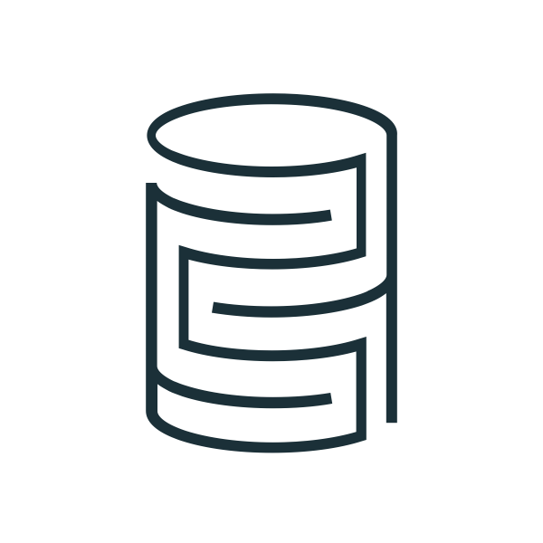





Streaming on the Lakehouse
DB Change Data Feeds
Lakehouse Platform
Live Dashboard
Near Real-time Query
Alert
Fraud Prevention
Dynamic UI
Dynamic Ads
Dynamic Pricing
Device Control
Game Scene Update
Etc.
Clickstreams
Streaming Ingesting
Streaming ETL
Event Processing
Event Driven Application
ML Inference
Machine & Application Logs
Unity Catalog Fine-grained governance for data and AI
Delta Lake
Data reliability and performance
Application Events
Cloud Data Lake
All structured and unstructured data
Mobile & IoT Data
Notes:
The lakehouse provides a wide variety of streaming capabilities from ingestion to ETL, event processing, event driven application and ML inference.
With these capabilities, you can realize impactful business use cases such as live dashboard, operational alert, dynamic UI, pricing, ads, etc.

Slide 10






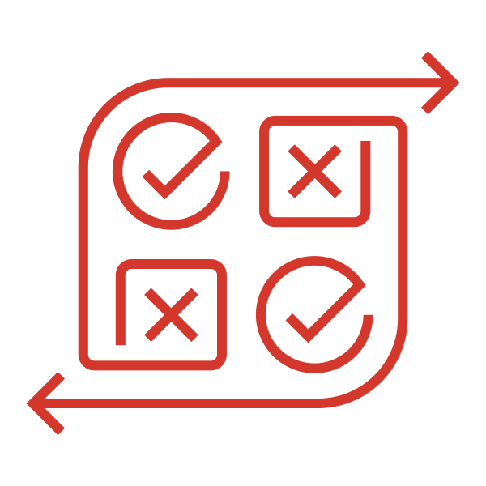







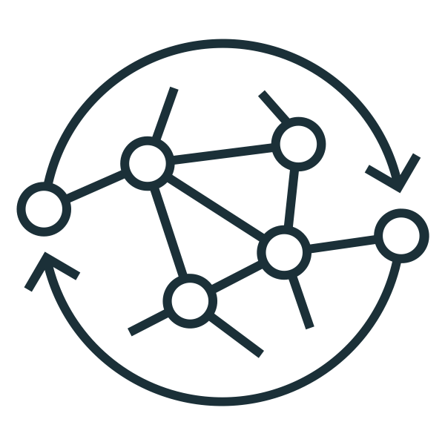



Modern data engineering in the lakehouse
Databricks Lakehouse Platform
Continuous batch or stream processing
Error handling and automatic recovery
Data pipeline observailability
Automatic deployments and operations
Orchestrate data pipelines
Business insights
Data transformation
Analytics
Data quality
Continuous or scheduled ingest
Bronze zone
Silver zone
Gold zone
Business level aggregates
Machine learning
Data quality
Photon
End-to-end Data Lineage
Operational apps
Notes:
Let’s take a look at how it works:
Building ETL pipelines to ingest and prepare data for ML and analytics is one of the most business critical workloads for data teams within the Lakehouse Platform.
HOW: Databricks DE enables data teams to
unify batch and streaming operations on a simplified architecture,
Modern SW engineer data pipeline development and testing,
build reliable data, analytics, and AI workflows on any cloud platform,
and meet regulatory requirements to maintain world-class governance.
RESULT: The Lakehouse provides an end-to-end data engineering and ETL platform that automates the complexity of building and maintaining pipelines and running ETL workloads so data engineers and analysts can focus on quality and reliability to drive valuable insights.

Slide 11




Delta Live Tables
Reliable data pipelines made dead simple
Accelerate ETL development Declare SQL or Python and DLT automatically orchestrates the DAG, handles retries, changing data
Automatically manage your infrastructure Automates complex tedious activities like recovery, auto-scaling, and performance optimization
Ensure high data quality Deliver reliable data with built-in quality controls, testing, monitoring, and enforcement
Unify batch and streaming Get the simplicity of SQL with freshness of streaming with one unified API
CREATE STREAMING LIVE TABLE raw_data
AS SELECT *
FROM cloud_files ("/raw_data", "json")
CREATE LIVE TABLE clean_data
AS SELECT …
FROM LIVE .raw_data
Notes:
Delta Live Tables (DLT) is the first ETL framework that uses a simple declarative approach to building reliable data pipelines and automatically managing your infrastructure at scale so data analysts and engineers can spend less time on tooling and focus on getting value from data. With DLT, engineers are able to treat their data as code and apply modern software engineering best practices like testing, error handling, monitoring and documentation to deploy reliable pipelines at scale.
Accelerate ETL development:
Unlike solutions that require you to manually hand-stitch fragments of code to build end-to-end pipelines, DLT makes it possible to declaratively express entire data flows in SQL and Python.
In addition, DLT natively enables modern software engineering best practices like the ability to develop in environment(s) separate from production, the ability to easily test it before deploying, deploy and manage environments using parameterization, unit testing and documentation. As a result, you can simplify the development, testing, deployment, operations and monitoring of ETL pipelines with first-class constructs for expressing transformations, CI/CD, SLAs and quality expectations, and seamlessly handling batch and streaming in a single API.
Automatically manage infrastructure:
Sizing clusters for optimal performance given changing, unpredictable data volumes can be challenging and lead to overprovisioning. DLT automatically scales compute to meet performance SLAs by providing the user with the option to set the minimum and maximum number of instances and let DLT size up the cluster according to cluster utilization.
Error handling and recovery, and performance optimization are all handled automatically. With DLT, you can focus on data transformation instead of operations.
Data confidence:
DLT makes it easy to create trusted data sources by including first-class support for data quality management and monitoring tools using a feature called Expectations.
Expectations help prevent bad data from flowing into tables, track data quality over time, and provide tools to troubleshoot bad data with granular pipeline observability so you get a high-fidelity lineage diagram of your pipeline, track dependencies, and aggregate data quality metrics across all of your pipelines.
Simplified batch and streaming:
Unlike other products that force you to deal with streaming and batch workloads separately, DLT supports any type of data workload with a single API so data engineers and analysts alike can build cloud-scale data pipelines faster and without needing to have advanced data engineering skills.

Slide 12
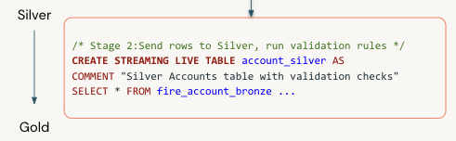
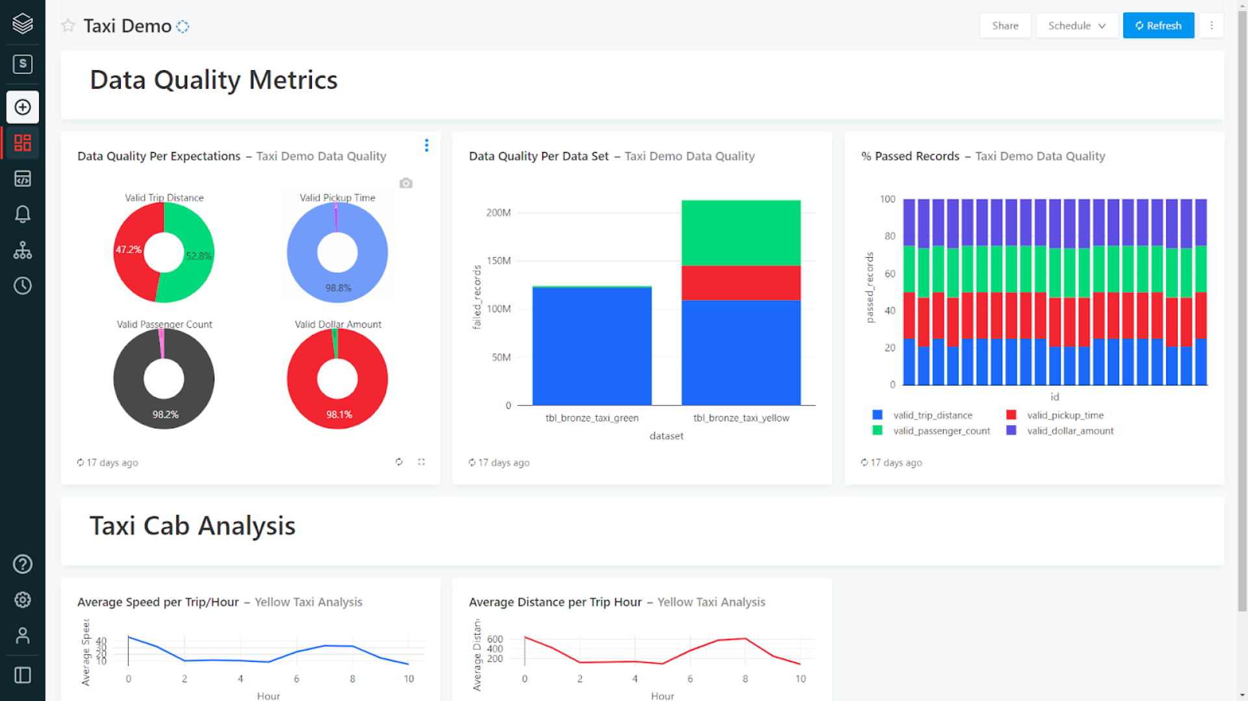
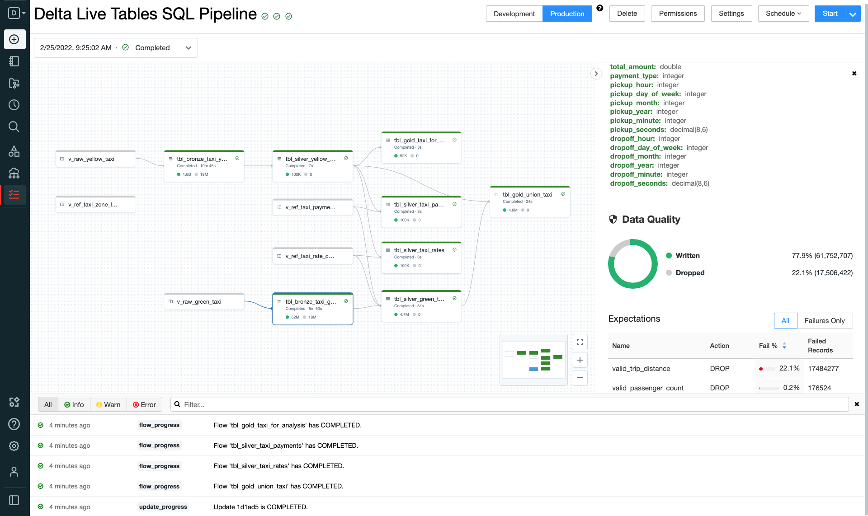
Delta Live Tables
Modern data engineering for ETL processing
Delta Live Tables (DLT) is the first ETL framework that uses a simple declarative approach to building reliable data pipelines. DLT automatically manages your infrastructure at scale so data analysts and engineers can spend less time on tooling and focus on getting value from data.
Describe dataflow
Declarative Real-time and Batch transformations, all in SQL/Python
Specify quality expectations
Define data quality and integrity controls
Scale with reliability
Grow rapidly and scale operations with clear observability
Notes:
Delta Live Tables (DLT) is the first ETL framework that uses a simple declarative approach to building reliable data pipelines and automatically managing your infrastructure at scale so data analysts and engineers can spend less time on tooling and focus on getting value from data. With DLT, engineers are able to treat their data as code and apply modern software engineering best practices like testing, error handling, monitoring and documentation to deploy reliable pipelines at scale.
Accelerate ETL development: Unlike solutions that require you to manually hand-stitch fragments of code to build end-to-end pipelines, DLT makes it possible to declaratively express entire data flows in SQL and Python. In addition, DLT natively enables modern software engineering best practices like the ability to develop in environment(s) separate from production, the ability to easily test it before deploying, deploy and manage environments using parameterization, unit testing and documentation. As a result, you can simplify the development, testing, deployment, operations and monitoring of ETL pipelines with first-class constructs for expressing transformations, CI/CD, SLAs and quality expectations, and seamlessly handling batch and streaming in a single API.
Automatically manage infrastructure: DLT was built from the ground-up to automatically manage your infrastructure and automate complex and time-consuming activities. Sizing clusters for optimal performance given changing, unpredictable data volumes can be challenging and lead to overprovisioning. DLT automatically scales compute to meet performance SLAs by providing the user with the option to set the minimum and maximum number of instances and let DLT size up the cluster according to cluster utilization. In addition, tasks like orchestration, error handling and recovery, and performance optimization are all handled automatically. With DLT, you can focus on data transformation instead of operations.
Data confidence: Deliver reliable data with built-in quality controls, testing, monitoring and enforcement to ensure accurate and useful BI, Data Science, and ML. DLT makes it easy to create trusted data sources by including first-class support for data quality management and monitoring tools using a feature called Expectations. Expectations help prevent bad data from flowing into tables, track data quality over time, and provide tools to troubleshoot bad data with granular pipeline observability so you get a high-fidelity lineage diagram of your pipeline, track dependencies, and aggregate data quality metrics across all of your pipelines.
Simplified batch and streaming: Provide the freshest/up-to-date data for apps with data self-optimized and auto-scaling data pipelines for batch or streaming processing and choose optimal cost-performance. Unlike other products that force you to deal with streaming and batch workloads separately, DLT supports any type of data workload with a single API so data engineers and analysts alike can build cloud-scale data pipelines faster and without needing to have advanced data engineering skills.

Slide 13

Data Engineering
Tens of millions of production workloads run daily on Databricks
Simplified data ingestion with Auto Loader and COPY INTO
Automated ETL with Delta Live Tables for batch and streaming data
Reliable orchestration for data, analytics, and AI with Databricks Workflows
End-to-end observability and monitoring
Notes:
Tens of millions of production workloads run daily on Databricks.
With the Databricks Lakehouse Platform, data engineers have access to an end-to-end data engineering solution for ingesting and transforming batch and streaming data, orchestrating reliable production workflows at scale, and increasing the productivity of data teams with built-in data quality testing and support for software development best practices.

Slide 14
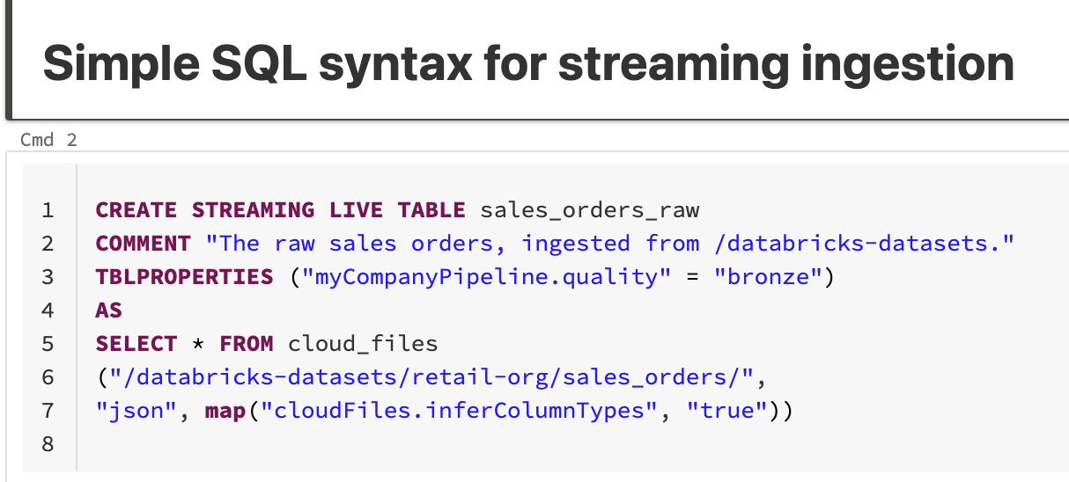
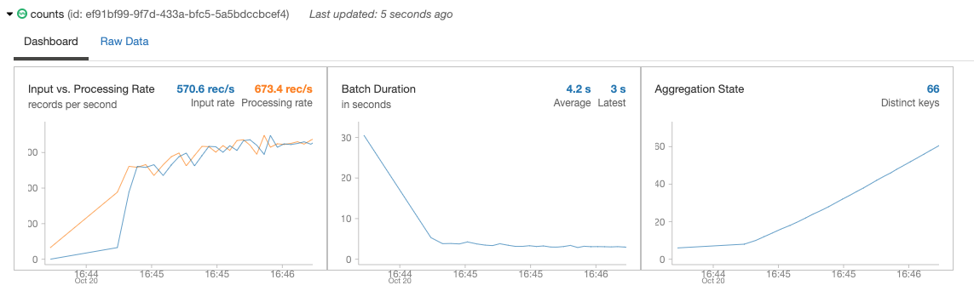
Continuous or scheduled data ingestion
Incrementally and efficiently process new data files as they arrive in cloud storage using AutoLoader
Automatically infer schema of incoming files or superimpose what you know with Schema Hints
Automatic schema evolution
Rescue data column—never lose data again
Schema Evolution
JSON
CSV
AVRO
PARQUET
Notes:
The first thing I wanted to talk about is getting data into Delta Lake. Ingesting data has to be reliable and has to scale. As volume grows, you need a way to ingest data easily, and with the ability to do change-data-capture, or CDC.
Auto Loader incrementally and efficiently processes new data files as they arrive in cloud storage. Auto Loader provides a Structured Streaming source called cloudFiles. Given an input directory path on the cloud file storage, the cloudFiles source processes new files with the option of also processing existing files in that directory.
Auto Loader can also infer schemas automatically, as well as evolve schemas dynamically by detecting the introduction of new columns to your data so you don’t have to manage the tracking and handling of schema changes yourself.
Auto Loader can also “rescue” data that was unexpected (for example, of differing data types) and set it aside so that you can choose to access it later.
Right now, schema evolution & inference is supported for JSON and CSV data, and we're bringing that same support to PARQUET soon.

Slide 15





Faster, smarter, and easier ingestion
Build hyper-scale robust ingestion pipelines in streaming and batch mode
Automatically ingest data in batch or streaming from cloud object files
Automatically infer schema of incoming files
Schema Hints—superimpose what you know on automatic inference
Automatically add new columns
Rescued data column—never lose data again
Notes:
With the Lakehouse platform, data engineers can build hyper-scale robust ingestion pipelines in streaming and batch mode
We continue our efforts in enhancing and supporting Auto loader, our powerful data ingestion tool for the Lakehouse. Auto Loader is an optimized data ingestion tool that incrementally and efficiently processes new data files as they arrive in cloud storage with minimal DevOps effort. In Q1 FY23 we will release the schema evolution capabilities for Parquet format. To recap all the main benefits for auto loader: it is performant with incremental listing, automatically infers schema and handle schema evolution, provide options for schema hints and handling unparsed data using rescued data column.
More details: Let’s recap main benefits Auto loader bring to our users in data ingestion workflow:
AutoLoader is an efficient way to bring data into Delta Lake in a streaming fashion.
Incremental listing mode:simply list from the last filename we have processed so as to only capture the new files. Directory listing doesn’t require any setup but it relist the directory entirely and can take time at stream start time. Notification mode solves this issue by listening to only new files but messages may expire and customers have to go to an extra step to set it up. Now with incremental listing (which will be default mode in autoloader) you get simplicity of directory listing with performance of notification listing mode
Auto Loader now supports automatic schema inference at stream start for all file formats.
Customers can also augment automatic inference with schema hints to set the table structure of your choice.
When ingesting JSON & CSV & Avro data, Auto Loader can now detect schema changes and separate out data or even entire columns that do not conform to the current schema (rescued data column) in additional unparsed columns without failing the ingestion jobs.
Customers can combine these new Auto Loader capabilities with Databricks jobs to automatically evolve schemas as the stream changes between micro-batches without causing interruptions.
Auto Loader will infer the schema of the incoming files (today users have to manually specify the schema).
In the real-world we often see files change their structure over time - new field appear or are missing. Auto Loader now will infer schemas of the arriving files and automatically handle changes in their schemas from the original
Auto Loader has interfaces through Python and Scala, and can be used with SQL through Delta Live Tables.

Slide 16
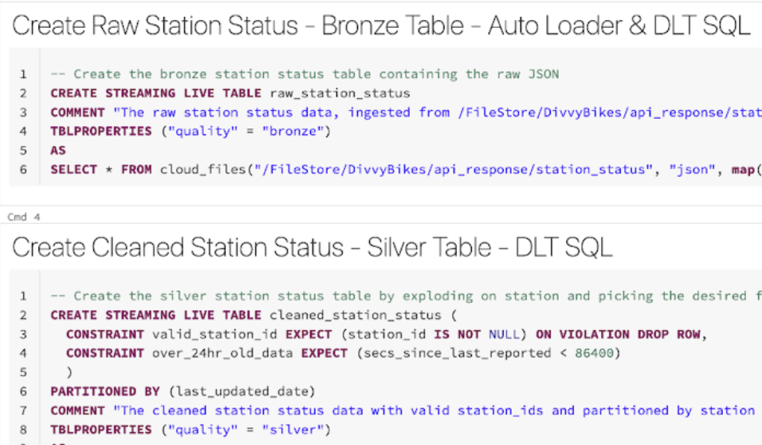
Data streaming
Democratize streaming for everyone
Unified batch and streaming
Provide diverse users with their favorite tools to work with streaming data
Easily configure the optimal cost structure for each of your streaming workloads
Out-of-the-box integrations with all popular message buses such as Apache Kafka, Kinesis, EventHub, etc
Notes:
The lakehouse architecture is designed to deliver streaming capabilities that enable real-time decisions and abstract the complexity of building streaming data pipelines on a single, unified platform.

Slide 17




DLT Differentiations
Unified Batch and Streaming
Your Favorite Tools
Optimal Cost Structure
End-to-End Streaming
No overhead of learning, developing on, or maintaining two sets of APIs and data processing stacks
Provide diverse users with their favorite tools to work with streaming data, enabling the broader organization to take advantage of streaming
Easily configure the right latency-cost tradeoff for each of your streaming workloads
Has everything you need, no need to stitch together different streaming technology stacks or tune them to work together
Notes:
The backbone of Lakehouse streaming, Spark Structured Streaming, was built with simplicity as its first principle. With that principle in mind, Structured Streaming and all of the Lakehouse streaming capabilities have a single and unified API for batch and stream processing. There is little to no new knowledge or skill to learn in order to adopt streaming on the Lakehouse.
The Lakehouse Platform provides diverse tools and interfaces for different personas. As a company develops and runs streaming workloads on the Lakehouse, there is no need for additional integration work in order for the entire organization to take advantage of streaming from everyone’s favorite tools and interfaces.
The Lakehouse Platform allows configurable processing frequency and size for each streaming workload so that a company can achieve the most optimal cost structure by making latency-cost tradeoffs at a workload granularity.
The Lakehouse is a well integrated end-to-end streaming platform. It provides out-of-the-box integrations with all popular message buses such as Apache Kafka, Kinesis, EventHub, etc. The foundational long-term storage system for the Lakehouse, Delta Lake, was built for streaming workloads from the beginning. Spark Structured Streaming is the processing engine that powers various streaming capabilities in the Lakehouse including Auto-Loader, Delta Live Tables, CDC, Materialized Views.

Slide 18
Recap
Delta Live Tables” to enhance modern DAP Architecture and Transformation Solution.
Delta Lives Tables is not just a technological advancement but also focuses on achieving business objectives.
Operational efficiency translated into higher customer service which in turn translates into increased Return On Investment (ROI).
Notes:
In today's ever-changing business world, organizations know they need to make the most of their extensive data to gain valuable insights. However, dealing with the challenges of data and analytics can be tough.
"Enterprises navigate data complexity to thrive in a fast-paced market, while Microsoft Fabric offers simplicity through OneLake and Unified Analytics. Let's delve into the details."
Microsoft Fabric is a comprehensive solution designed to address the complex data and analytics challenges faced by modern enterprises.

Slide 19
Q & A

Slide 20
Appendix

